Slide 1

Montana’s Economic Recovery: Making Sense of Mixed Signals
Patrick M. Barkey and Paul E. Polzin
Bureau of Business and Economic Research
The University of Montana - Missoula

Slide 2
2010: Predictions and Surprises
Inventory Correction Fuels U.S. Growth Spurt
Consumer Spending Holds Back Growth
Employment Growth Turns Positive, Barely
Montana Income Tax Withholdings Swing to Growth
Europe’s Weakest Economies Max Out Their Credit Cards
Gulf Oil Spill is Worst in History
Montana Income Growth Revised Sharply Downward

Slide 3
New Concerns For Montana
Correction in Housing Still Not Finished
U.S. Consumer Confidence Stuck in a Rut
No More Stimulus to Bail Out State Government
Downward Assessment of Global Economic Growth

Slide 4
Montana’s Recession Experience
Payroll Employment, Index, September 2008 = 100
Montana
U.S.
2007
2008
2009
2010
Notes:
4

Slide 5
Montana’s Recession Experience
Nonfarm Labor Earnings, 2007Q4 = 100
North Dakota
Montana
U.S.
Nevada
2007
2008
2009
2010
Notes:
5

Slide 6
The Outlook for U.S. Growth
After spurt to begin the year, growth falls back
Growth has been unbalanced
High productivity gains have limited the need for new hiring
Concern over Europe, unemployment, and sluggish consumer spending have downgraded forecasts

Slide 7
Half of Those Unemployed
are Long-Term Jobless
> 27 weeks
14-27 weeks
5-14 weeks
< 5 weeks

Slide 8
But Private Borrowing is in Reverse
Commercial and Industrial Loans at all Commercial Banks (BUSLOANS)
Source: Board of Governors of the Federal Reserve System
Billions of Dollars

Slide 9
Montana’s Economic Base
Current Status
Nonresident Travel
Mining
Manufacturing
  Wood and Paper
  Other Manufacturing
Agriculture
Federal Government (Incl. Military)
Weak Recovery
Positioning for Growth
90%
Permanent Closures
Recovering
Back to Long-term Average
Stimulus
Construction
Montana State Government
No Rebound in Sight
Significant Cuts Ahead

Slide 10
Montana’s Energy Industries
Labor Income and Basic Industries, Montana
Mining, 14%
Wood and Paper, 6%
Ag. and Related, 8%
Travel, 13%
Selected Manufacturing, 16%
Transportation, 13%
Fed. Military, 9%
Fed. Civilian, 21%

Slide 11
Montana’s Energy Industries
Coal Mining NAICS 2121
2009 Employment = 946
Number of firms = 7
Coal Mining Employment

Slide 12
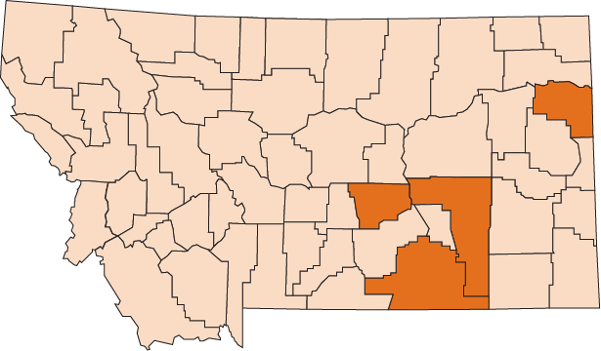
Montana’s Energy Industries
Coal Mining NAICS 2121
2009 Employment = 946
Number of firms = 7

Slide 13
Montana’s Energy Industries
Coal Mining NAICS 2121
2009 Employment = 946
Number of firms = 7
Wages and Salaries per Worker
$72,250
State average = $33,800

Slide 14
Montana’s Energy Industries
Petroleum Refining NAICS 32411
2009 Employment = 1,069
Number of firms = 4
Petroleum Refining Employment

Slide 15
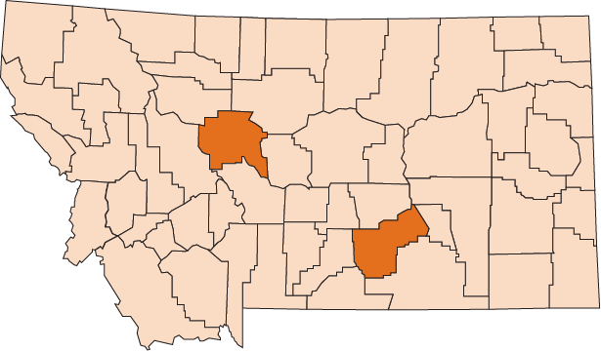
Montana’s Energy Industries
Petroleum Refining NAICS 32411
2009 Employment = 1,069
Number of firms = 5

Slide 16
Montana’s Energy Industries
Petroleum Refining NAICS 32411
2009 Employment = 1,069
Number of firms = 4
Wages and Salaries per Worker
$95,800
State average = $33,800

Slide 17
Montana’s Energy Industries
Drilling Oil and Gas Wells NAICS 21311
2009 Employment = 333
Number of firms = 49
Drilling Oil and Gas Wells Employment

Slide 18
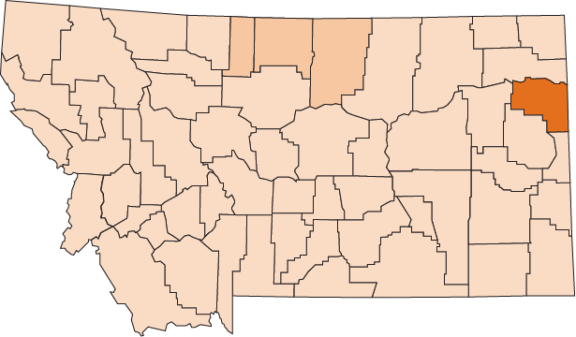
Montana’s Energy Industries
Drilling Oil and Gas Wells NAICS 21311
2009 Employment = 333
Number of firms = 49

Slide 19
Montana’s Energy Industries
Drilling Oil and Gas Wells NAICS 21311
2009 Employment = 333
Number of firms = 49
Wages and Salaries per Worker
$64,800
State average = $33,800

Slide 20
Montana’s Energy Industries
Support Activities for Oil and Gas NAICS 213112
2009 Employment = 1,256
Number of firms = 159
Support Activities for Oil and Gas Employment

Slide 21
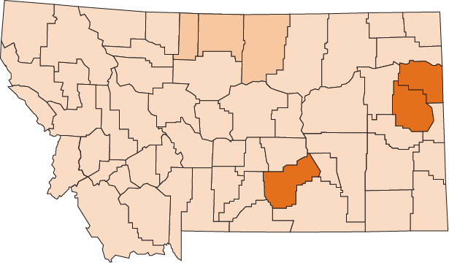
Montana’s Energy Industries
Support Activities for Oil and Gas NAICS 213112
2009 Employment = 1,256
Number of firms = 159

Slide 22
Montana’s Energy Industries
Support Activities for Oil and Gas NAICS 213112
2009 Employment = 1,256
Number of firms = 159
Wages and Salaries per Worker
$92,500
State average = $33,800

Slide 23
Montana’s Energy Industries
Oil and Gas Pipeline Construction NAICS 23712
2009 Employment = 428
Number of firms = 31
Oil and Gas Pipeline Construction Employment

Slide 24
Montana’s Energy Industries
Oil and Gas Pipeline Construction NAICS 23712
2009 Employment = 428
Number of firms = 31
Wages and Salaries per Worker
$54,700
State average = $33,800

Slide 25
Montana’s Energy Industries
Pipeline Transportation NAICS 486000
2009 Employment = 441
Number of firms = 41
Pipeline Transportation Employment

Slide 26
Montana’s Energy Industries
Pipeline Transportation NAICS 486000
2009 Employment = 441
Number of firms = 41
Wages and Salaries per Worker
$68,800
State average = $33,800

Slide 27
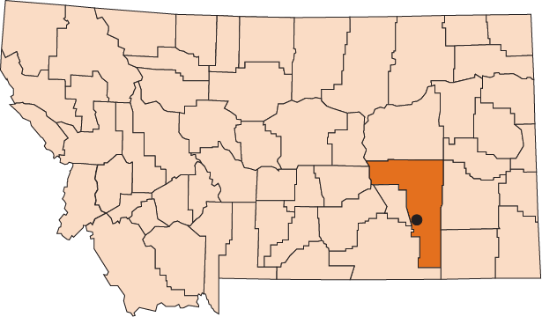
Montana’s Energy Industries
Colstrip Steam Electrical Station
2009 Employment = 578
Number of firms = 1

Slide 28
Montana’s Energy Industries
Colstrip Steam Electrical Station
2009 Employment = 578
Number of firms = 1
Wages and Salaries per Worker
$64,800
State average = $33,800

Slide 29
Montana’s Energy Industries
Montana’s Energy Industries

Slide 30
Montana’s Energy Industries
Rim Rock Wind Farm, Sunburst MT
Construction – 2 Years
300 Workers / Year
$110,000 / Year
Operations
22 Workers
$48,000 / Year

Slide 31
Actual and Projected Change in Nonfarm
Labor Income, Montana, 2007-2013
Percent
Actual
Projected

Slide 32
Questions?

